Slide 1
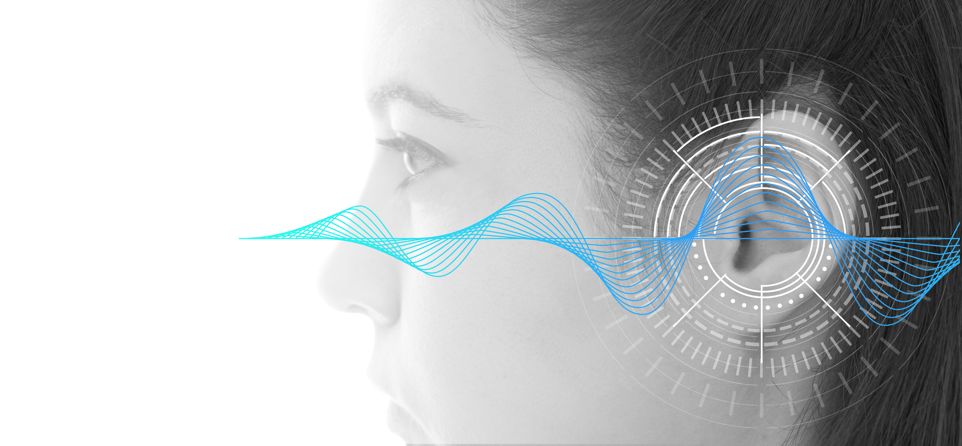
PHYSICS OF HEARING
NJ-OER TOPIC-17

Slide 2
Learning Outcomes
Describe sound as a longitudinal wave. Describe the relationship between the speed of sound, its frequency, and its wavelength. Describe the effects on the speed of sound as it travels through various media. Describe the effects of temperature on the speed of sound. Define sound intensity, and sound pressure level. Calculate sound intensity levels in decibels (dB). Define Doppler effect, Doppler shift, and sonic boom. Calculate the frequency of a sound heard by someone observing Doppler shift. Define antinode, node, fundamental, overtones, and harmonics for standing waves. Identify sound interference. Calculate the length of a tube using sound wave measurements.

Slide 3
Concepts
v = speed of wave vs=speed of source source vo=speed of observer f= frequency λ = wavelength F= force I = Intensity of a sound wave 0 dB=threshold of hearing = 1.0 × 10⁻¹² W/m² 𝛽= sound intensity level, decibel value P = power μ = mass/length fo= frequency of observer fs= frequency of source fn= frequency of nth harmonic fbeat= beat frequency

Slide 4
Units
SI UNITS Frequency is in HZ Wavelength is in meters Velocity is in m/s Power is in Watts Intensity is in W/m2 𝛽 is a logarithmic scale for intensity and it is in dB

Slide 5
Formulas and Constants
f = 1/T v = λ f = λ /T v²= F/(mu) mu=m/L v= 331 (Tk/273)^{½} fo=fs(V±Vo)(/V∓Vs) Doppler shift fn= n(v/2L) n = 1, 2, 3, … (harmonics for pipe Open-open/Closed-closed) fn= n(v/4L) n = 1, 3, 5, … (harmonics for pipe open at one end) fbeat=|f1-f2| I = P/A I=P/(4πr²) (I1)/(I2) = (R1)²/(R2)² I_{o}= 1.0 × 10⁻¹² W/m²

Slide 6
USEFUL TABLES
Medium​ | vw(m/s)​
Gases at 0ºC​
Air​ | 331​
Carbon dioxide​ | 259​
Oxygen​ | 316​
Ratios of Intensities and Corresponding Differences in Sound Intensity Levels
Liquids at 20ºC​
Ethanol​ | 1160​
Mercury​ | 1450​
Water, fresh​ | 1480​
Sea water/Human tissue​ | 1540​
I2/I1 | β2–β1
2.0 | 3.0 dB
5.0 | 7.0 dB
10.0 | 10.0 dB
Solids ​
Vulcanized rubber​ | 54​
Polyethylene​ | 920​
Marble​ | 3810​
Glass, Pyrex​ | 5640​
Speed of Sound in Various Media

Slide 7
CLASSWORK POWER AND INTENSITY
Q1) A rectangular receiver with length 0.3 m and height 0.6 m receives 24 Watts of power.
a)What is the sound intensity at the receiver’s location.
b)What is the sound intensity in decibel.
c)What is the power of the source considering that it is 5 meters away from the receiver.
Q2) A sound speaker produces 12W power.
a) What is the intensity at 7 meters away.
b) What is the power received by a circular receiver with radius 0.4 meters.
Q3) Ten drummers produces 34dB sound intensity from a 2 meters distance.
a) What would be the sound intensity of 100 drummers heard from a 2meters distance (in decibel)
b) What would be the sound intensity of 100 drummers heard from a 20 meters distance (in decibel)
Q4) A sound wave produces 10,000 Pascal pressure difference at 0 degrees temperature. Find its intensity
I = P/A I=P/(4πr2) (I1)/(I2) = (R1)2/(R2)2 I = (Δp2) /(ρ v) v= 331 (Tk/273)½ ρ(air)=1.225 kg/m³
Io= 1.0 × 10-12 W/m2 β = 10 log (I/Io) rules for β: If intensity increases 10 times, add ten to β

Slide 8
STANDING WAVES
Typical standing waves for a woodwind instrument with both sides open or closed
n=1,2,3,…..
Typical standing waves for a woodwind instrument with only one side open
n=1,3,5,…..
Q) Find the wavelengths and the frequencies for each graph. Consider L=0.420 m and v = 340 m/s

Slide 9
ADVANCED CLASSWORK FOR STANDING WAVES
A tube with length "L", produces sound with frequency "fn" by forming standing waves with n number of antinodes. Air is at the temperature "T" in Kelvin.
Complete the table below using the known quantities and the formula.
f Frequency Hz | Wavelength (m) | n | Length (m) | Type of tube | Temperature | Velocity
f4=? |  | 4 | 0.50 | both end closed |  | 331 m/s
f5=? |  | 5 | 0.80 | one end closed | 300K
 |  |  | 0.75 | both end open |  | 343
 | 0.44 |  | 0.66 |  |  | 340
v = λ f
fn= n(v/2L) n = 1, 2, 3, … (harmonics for pipe Open-open/Closed-closed)
fn= n(v/4L) n = 1, 3, 5, … (harmonics for pipe open at one end)

Slide 10
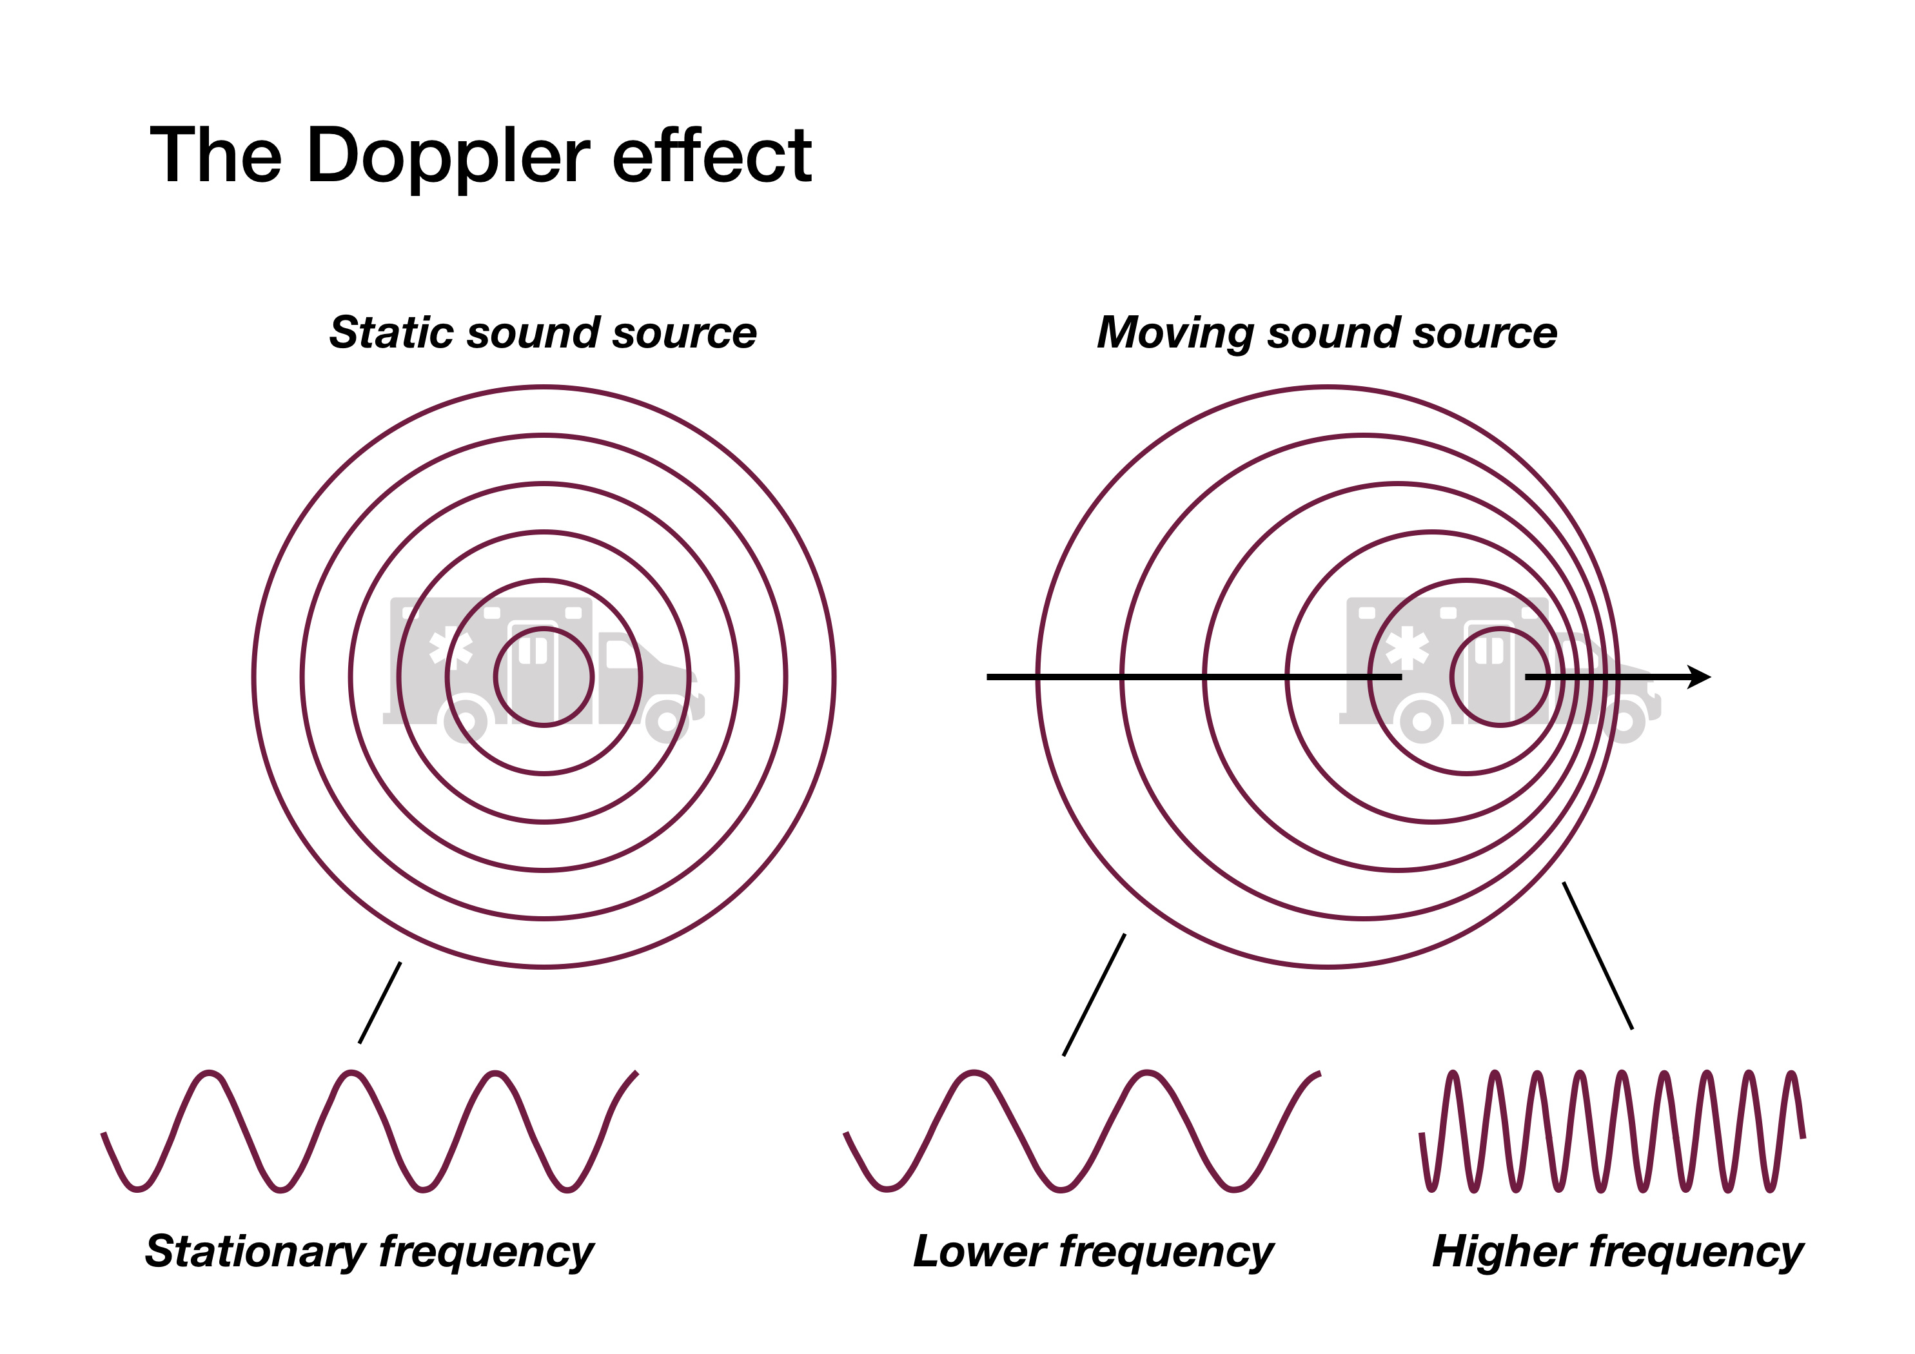
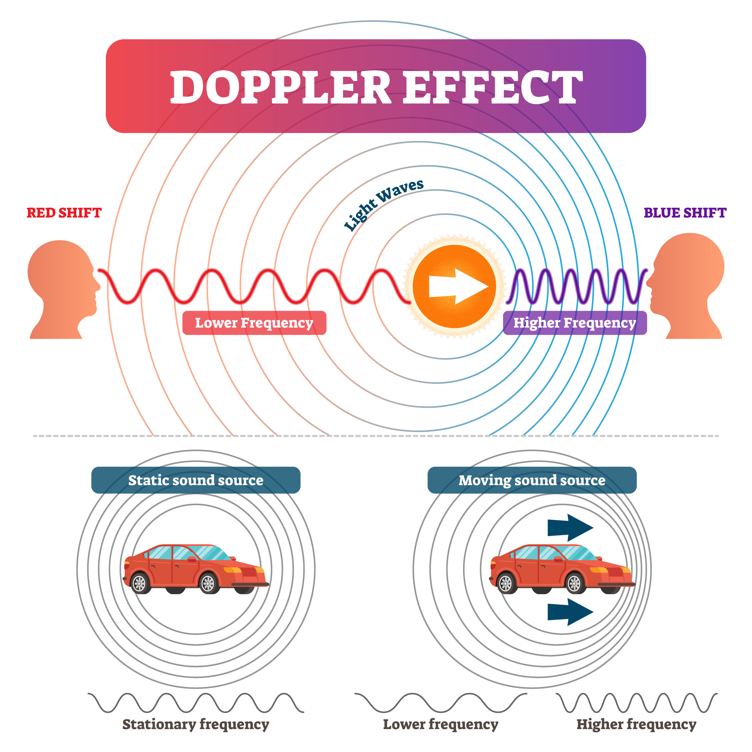
DOPPLER EFFECT
Doppler effect is a frequency shift, it doesn't affect the velocity but it effects the wavelength as well. Doppler formula relates frequency heard by the observer to the original source frequency.
Formula | Motion
fobs=fs (v+vobs)/(v-vs) | Observer and source move towards one another
fobs=fs (v-vobs)/(v+vs) | Observer and source move away from one another
fobs=fs (v+vobs)/(v+vs) | Observer moves towards, source moves away
fobs=fs (v-vobs)/(v-vs) | Observer moves away, source moves towards
fobs= frequency observed
fs= frequency of the source
vs= speed of the source, (this is a + quantity, sign comes from the table)
vobs= speed of the observer, (this is a + quantity, sign comes from the table)
v= speed of sound

Slide 11
CLASSWORK DOPPLER EFFECT
Formula | Motion
fobs=fs (v+vobs)/(v-vs) | Observer and source move towards one another
fobs=fs (v-vobs)/(v+vs) | Observer and source move away from one another
fobs=fs (v+vobs)/(v+vs) | Observer moves towards, source moves away
fobs=fs (v-vobs)/(v-vs) | Observer moves away, source moves towards
Using the sign convention table,
answer the following questions.
Stationary means v=0
Take speed of sound as 340m/s
Q1) A police car has siren with frequency 1000Hz. The car is moving with a speed of 34m/s
a)What is the frequency heard by a stationary observer when the car is approaching
b)What is the frequency heard by a stationary observer when the car is moving away
Q2) Sound source with 450 HZ frequency is moving with a speed of 17m/s towards East. What is the frequency heard by an observer located East of the sound source and moving with a speed 42m/s towards East.
Q3) A moving sound source is observed as 95HZ when moving towards the observer and it's observed as 90HZ when moving away from the observer. What is the speed of the source. What is the original source frequency
(This is a problem with two equations and two unknowns)

Slide 12
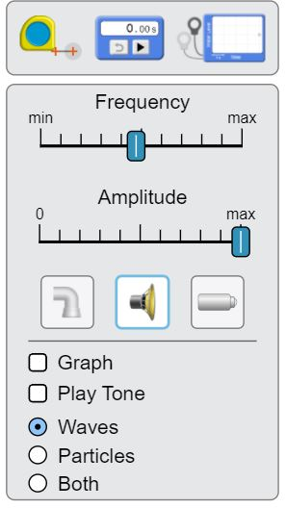
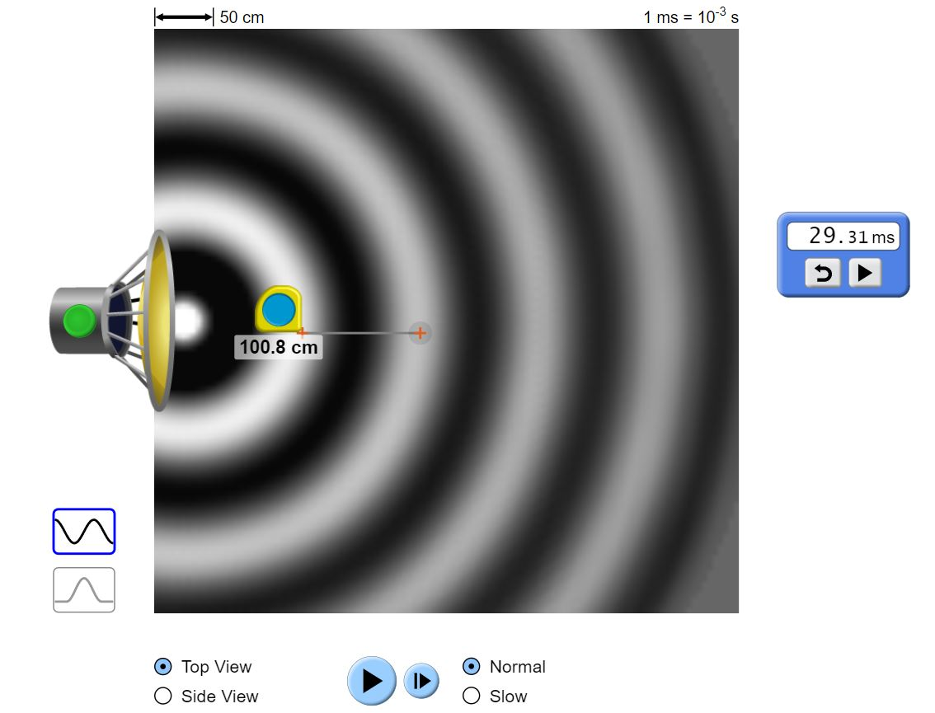
ACTIVITY ON WAVE PROPERTIES OF SOUND
Ruler
Open the link https://phet.colorado.edu/en/simulations/wave-interference and click on the app
Choose the middle option under the amplitude tab on the right. This will make the wave a sound wave.
Choose your frequency and amplitude using the slider tool. Drag the timer and the ruler tool.
Start your times and start your source. Count 10 waves and stop the timer and the source.
Timer gives you the time for 10 oscillations. To find the period, divide this number by 10
Use f=1/T formula to calculate the frequency. Measure the wavelength using the ruler tool
Using v= frequency * wavelength calculate the speed of sound. Using v=331 (T/273)^{½} estimate the temperature of the environment. Change the frequency and amplitude and repeat
Timer
Sound option

Slide 13
ACTIVITY ON WAVE PROPERTIES OF SOUND
Open the link https://phet.colorado.edu/en/simulations/wave-interference and click on the app
Type | Time for 10 waves | Period | Frequency | Wavelength | Speed | Temperature
Frequency minimum
Frequency middle
Frequency middle
Frequency maximum
Frequency maximum

Slide 14
ACTIVITY ON INTERFERENCES
Open the link https://phet.colorado.edu/en/simulations/wave-interference and click on the app
Type | Time for 10 waves | Period | Frequency | Wavelength | Speed | Temperature
Frequency minimum
Frequency middle
Frequency middle
Frequency maximum
Frequency maximum

Slide 15
REFERENCES
Slide 1: Adobe id= 216379246 Hearing test showing ear of young woman with sound waves simulation technology By Pixsooz
Slide 8: Open Stax College Physics online textbook
Slide 10 Top image: Adobe id=388859337 The Doppler effect explained by comparing a static and a moving sound source By Dimitrios
Slide 10 Lower image: Adobe id= 305961504 Doppler effect vector illustration. Labeled educational sound, light graph.
By VectorMine
Slides 12-13-14: Screenshot from PhET Interactive Simulations University of Colorado Boulder

